Slide 1


Arxiv paper blog generation ——application of nougat
主讲人：
浙江大学融媒体中心学生记者团出品

Slide 2



Contents
1
Motivation
2
Functionalities
3
Detailed Design
4
Future Planning

Slide 3
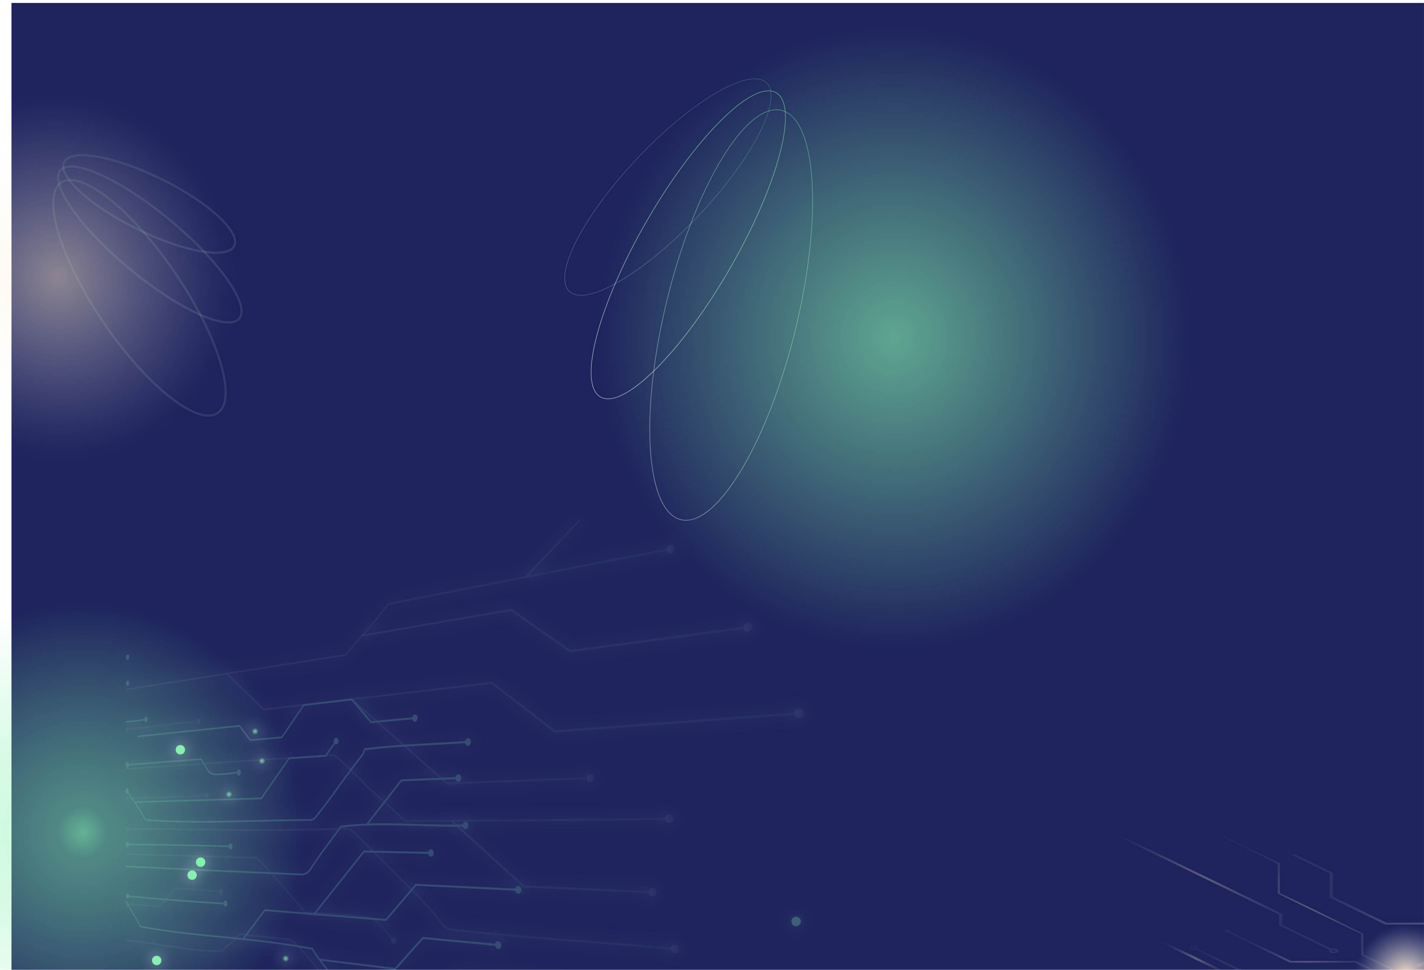

Motivation
1

Slide 4

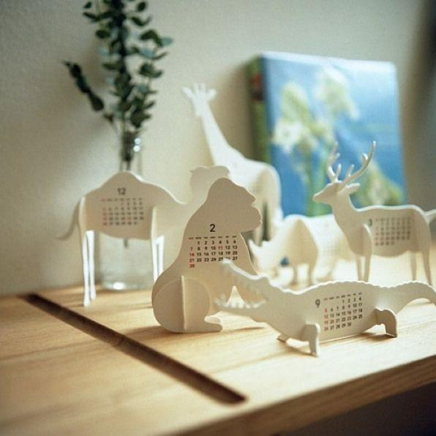

Motivation
01
02
In this era of information explosion, scientific researchers are faced with not only a lack of information, but also information overload.
Traditional automatic summarization tools often fail to meet the needs for personalization and in-depth interpretation.
03
04
Traditional OCR cannot accurately extract PDF information
The original text of the paper is too long, and it is easy to lose information if it is arbitrarily cut off, and the meaning is incoherent.

Slide 5
Functionalities
2

Slide 6
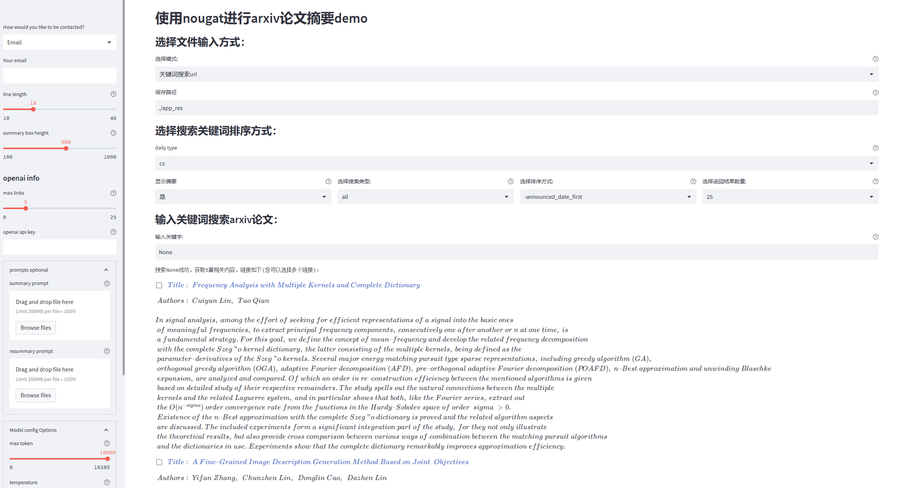
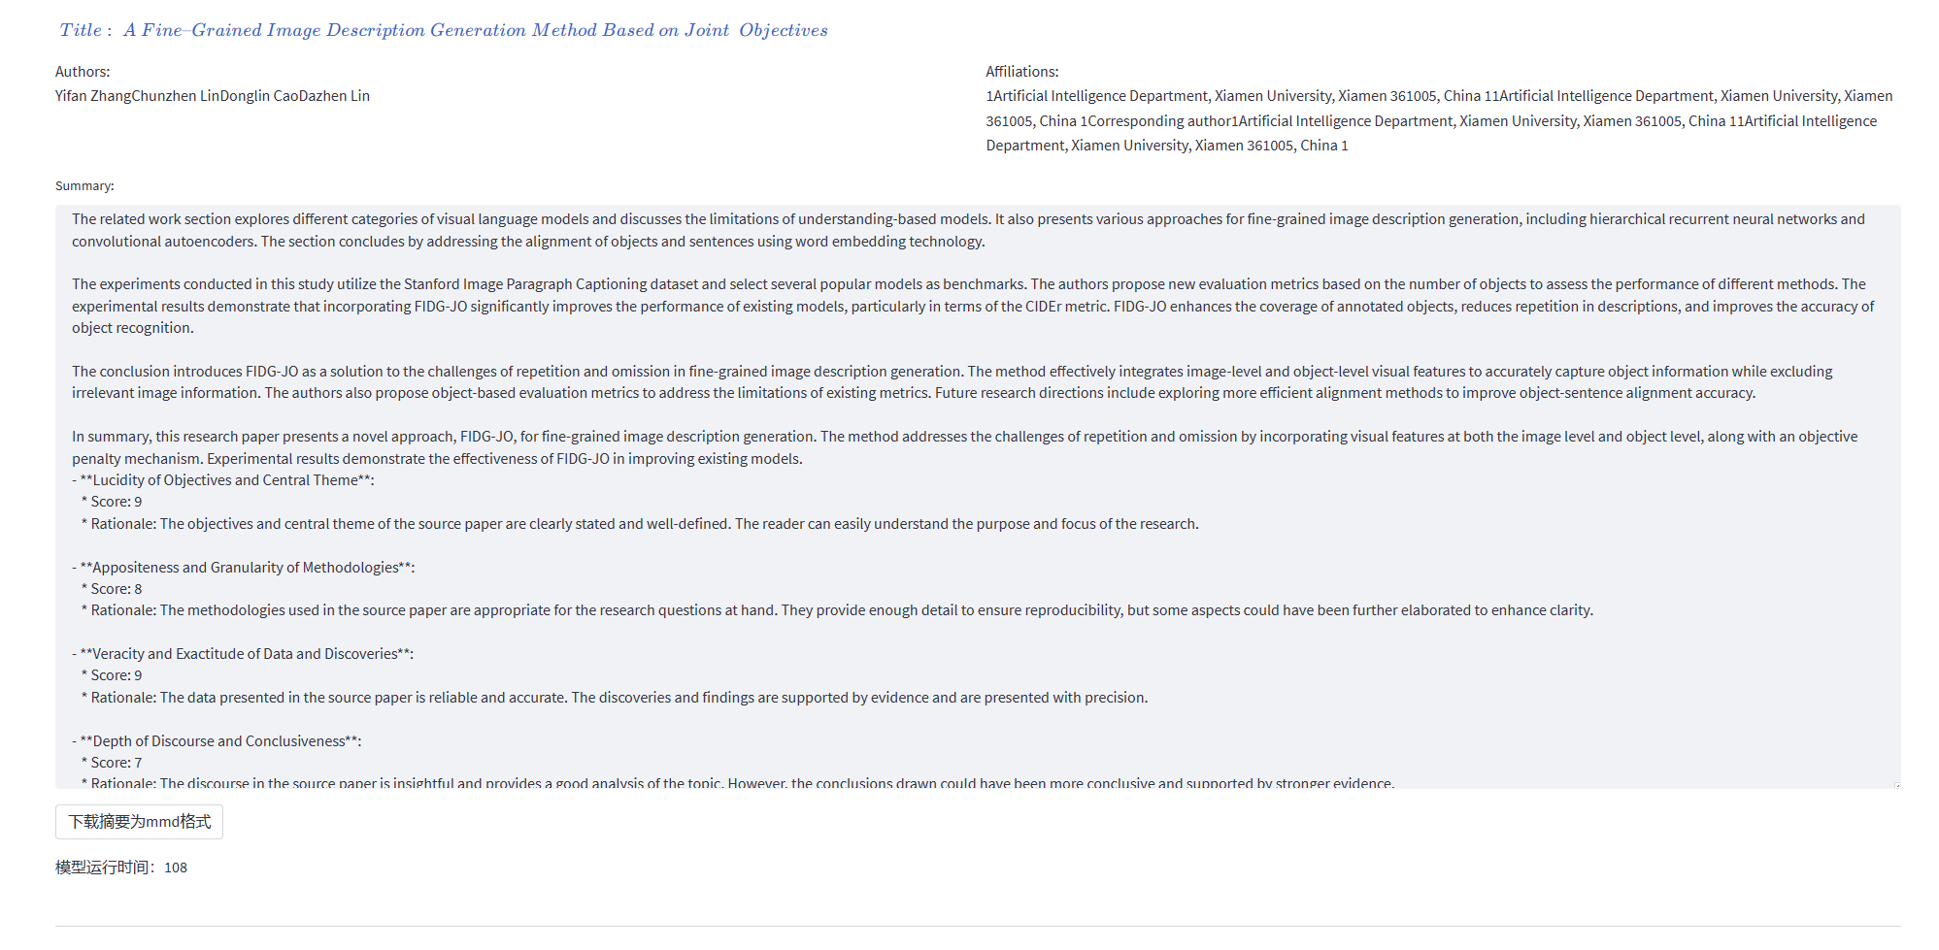
Overview

Slide 7
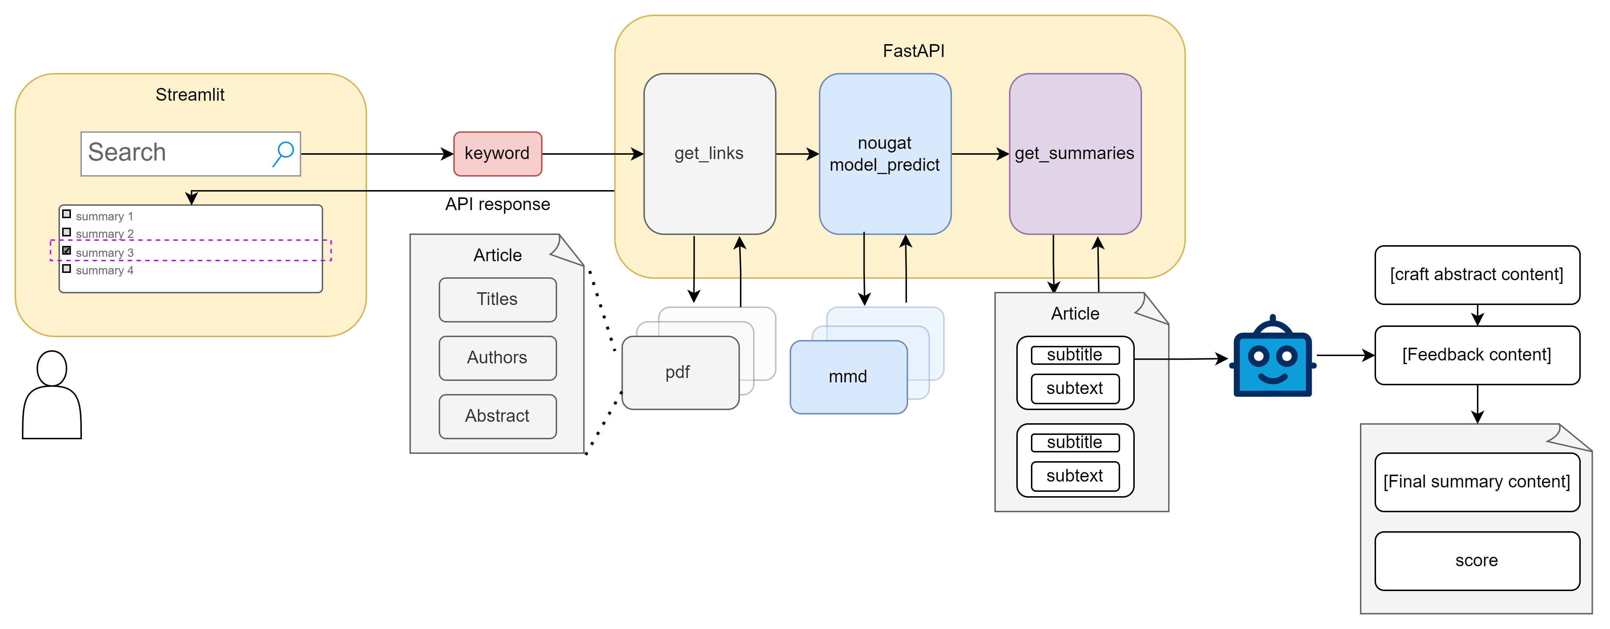
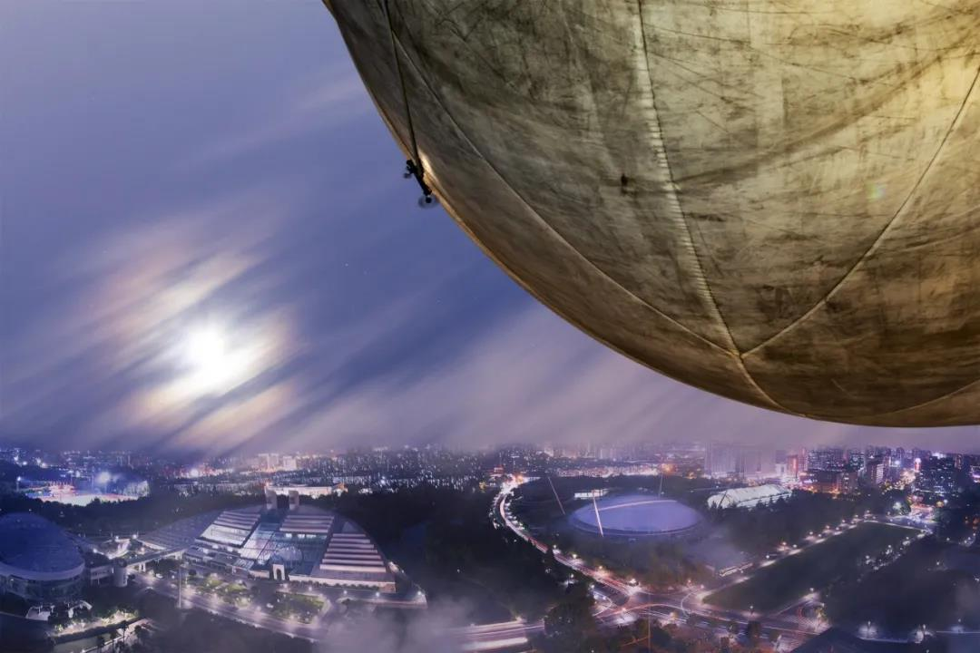
Workflow & Composition
Nougat
Convert PDF to MMD format to minimize loss of original paper information.
Get links
Using the user-input keyword, obtain initial information on arXiv papers for preliminary screening.
Get Summary
Group the abstract based on the format, then guide the writing process to create a scholarly blog interpreting the paper.
待输入

Slide 8
Advantage
72%
60%
50%
75%
Accuracy
Consistency
Interactivity
Compatibility
Nougat accurately parses PDF information into MMD format, preserving the original paper's structure and table content to minimize information loss.
Generate a scholarly blog by crafting segmented summaries from subgroups and synthesizing them. Ensure coherence and focus on the core contributions of the paper.
By engaging in front-end interactions, users can tailor prompts and model parameters for improved summary outcomes.
Supports Markdown-formatted content, including LaTeX mathematical formulas, for enhanced presentation quality.

Slide 9
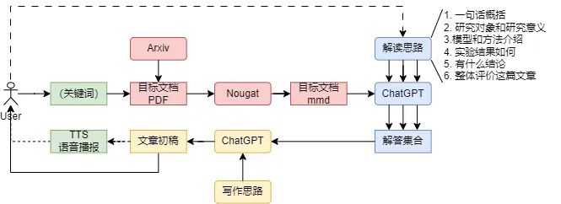


阶段三
阶段二
阶段四
阶段一
阶段五

Slide 10
Detailed Design
3

Slide 11
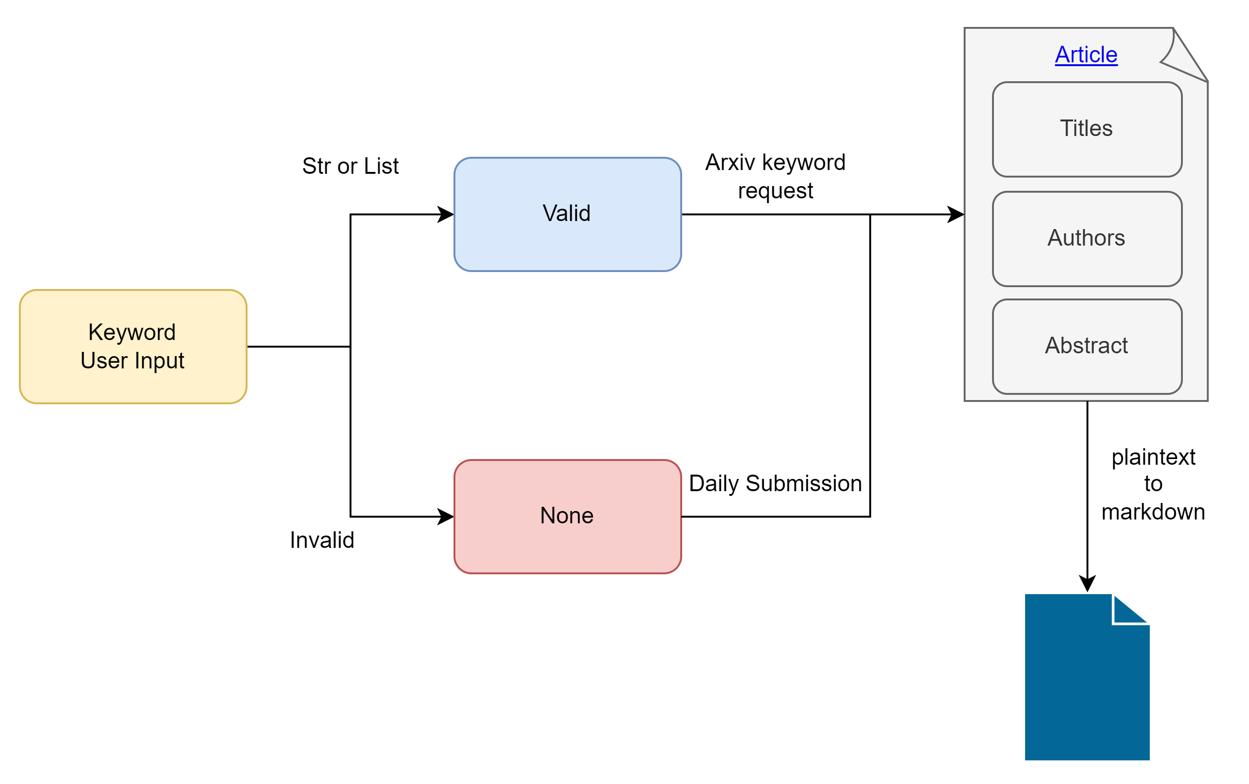
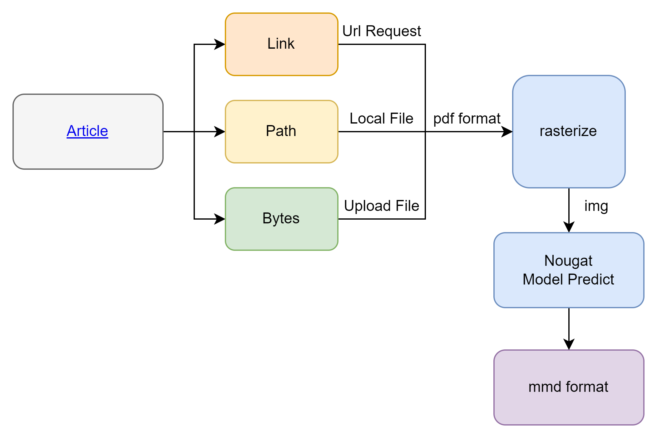
Get Links
Nougat

Slide 12
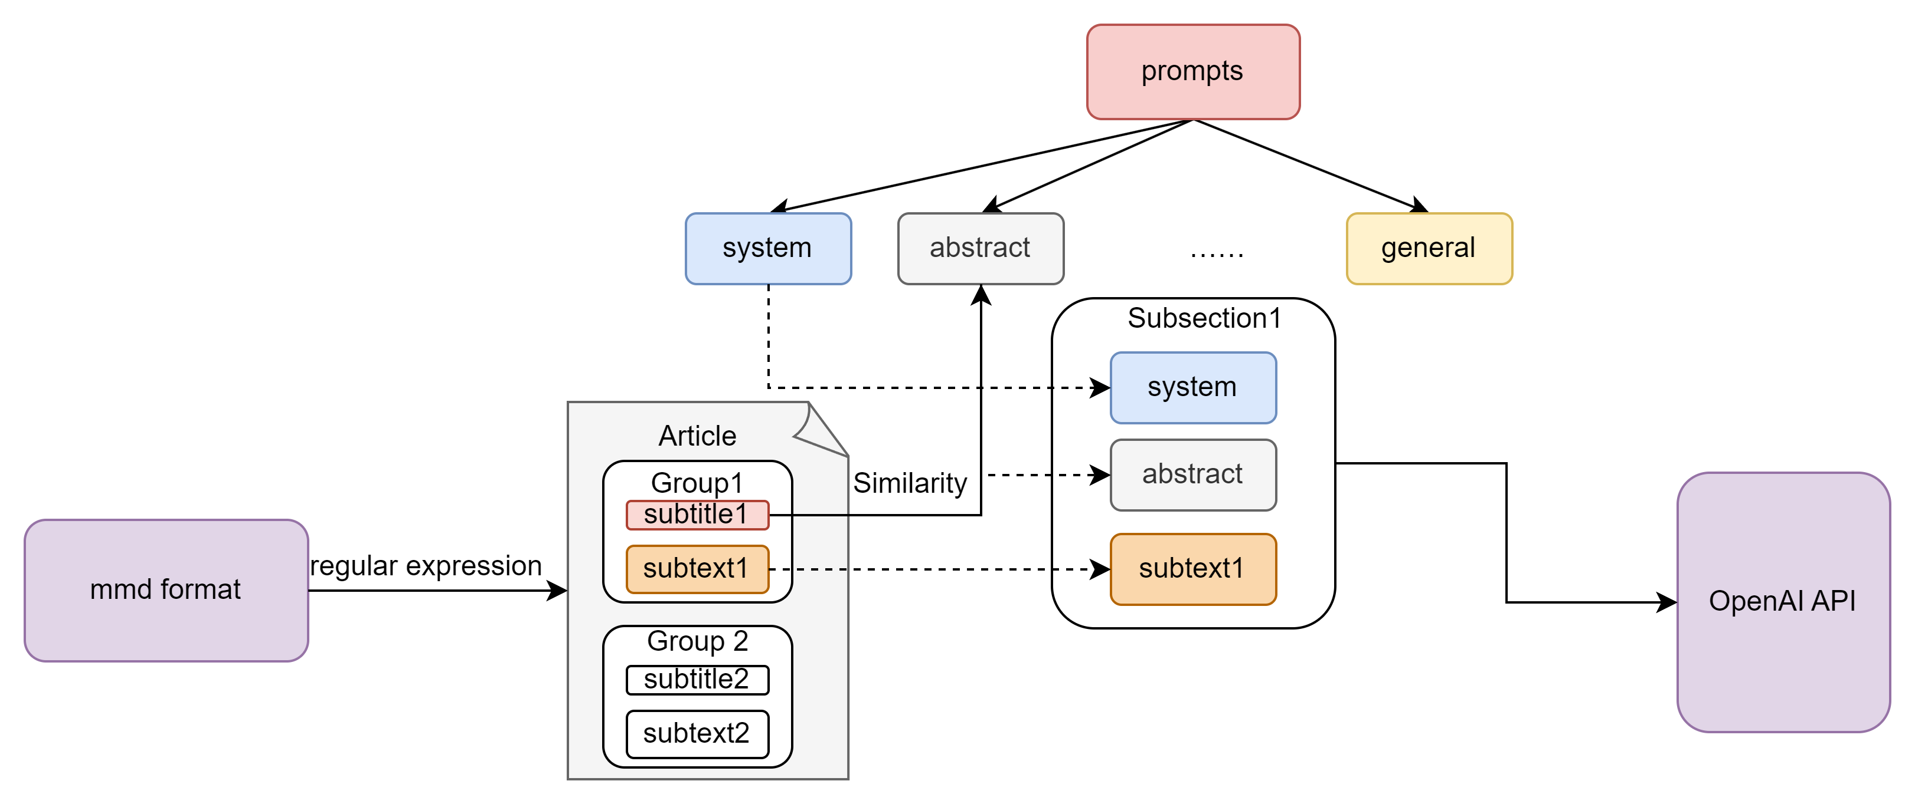
Get Links

Slide 13
Future Planning
4
待输入文字

Slide 14

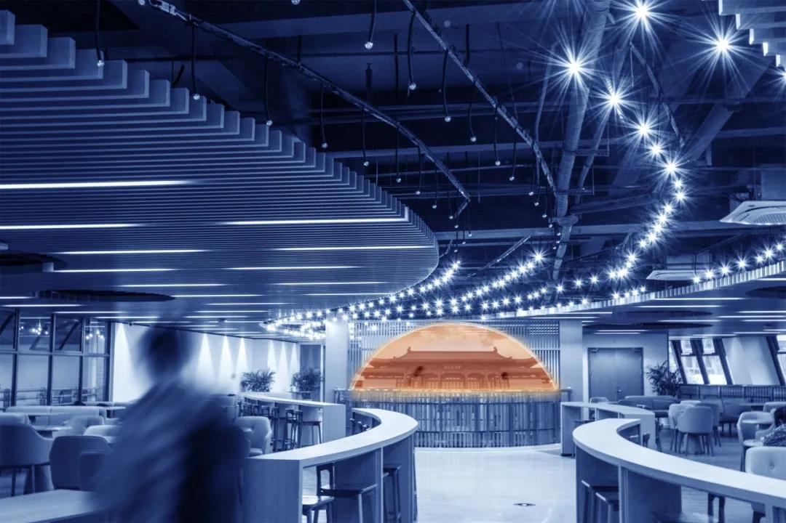
S
W
Speed
Compatibility
Speed ​​up the overall process and reduce user waiting time
allow users to save and share the generated content in multi format."
O
T
Interactivity
Comparison
Provide more exquisite and diverse playgrounds
Available for comparison of multi-model results

Slide 15

感谢观看
待输入文字

